Slide 1
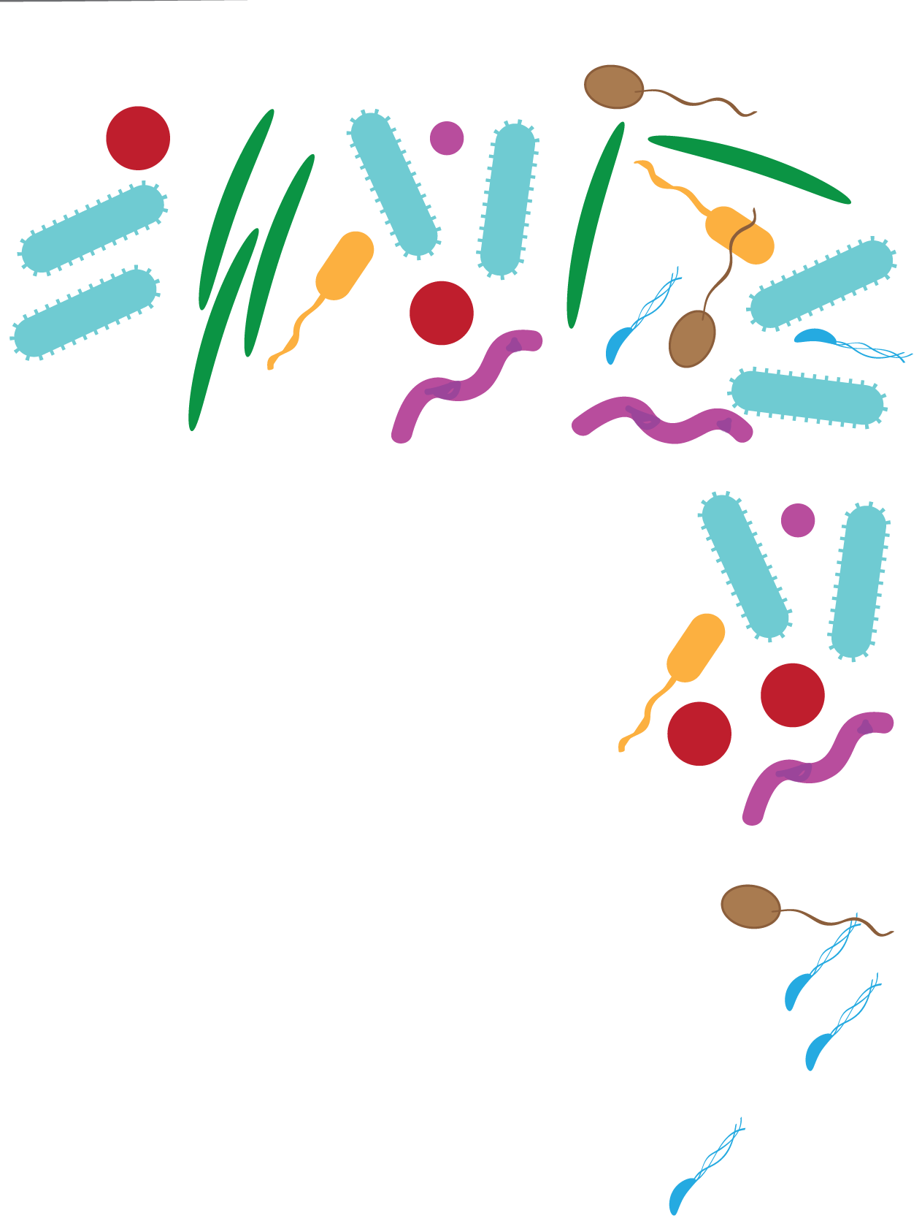
Computational Biology Patterns of microbial community change
Jesse Zaneveld

Slide 2
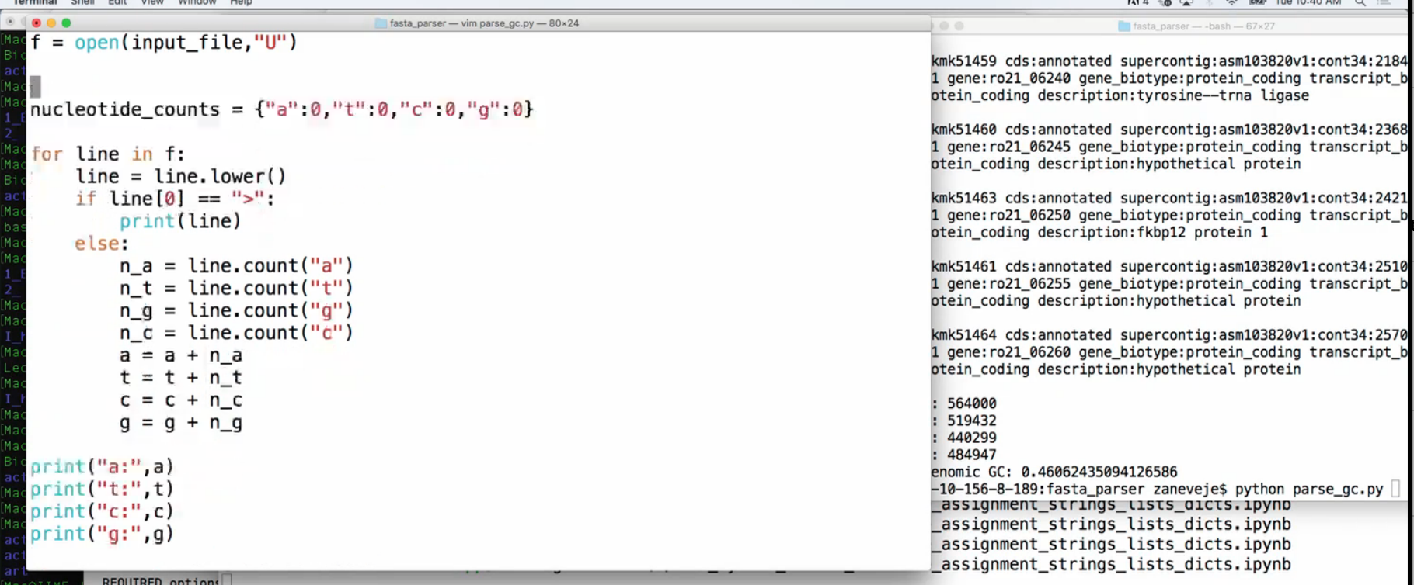
Python Scripts
Terminal 1 – Typing in Vim (or you could use Notepad,
Atom, Emacs, etc…) and saving to parse_gc.py
Terminal 2 – Actually running
the code by calling:
python parse_gc.py

Slide 3
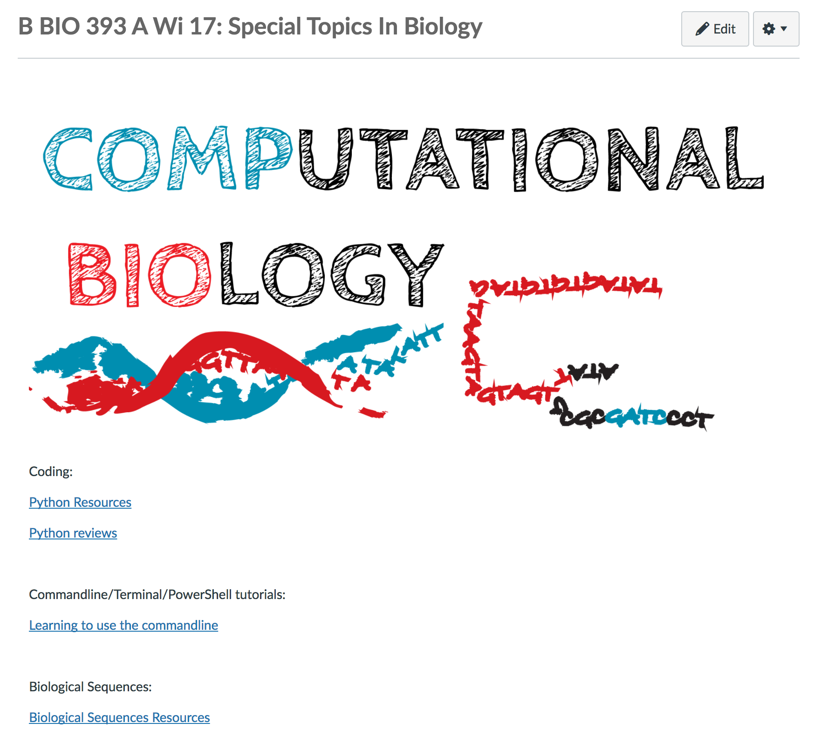
Computational Biology: Questions
Questions from last time:
Some folks wondered how to review/learn more commands for Windows PowerShell.
I added a link to a very extensive cheatsheet comparing Unix/MacOSX commands and powershell
on Canvas. Go to ‘Learning to use the commandline’ and it will be the top link.

Slide 4
Project 1 Proposals
By next Monday please submit a project proposal for Project 1.
Project 1 will be a first chance to write your first complete python script. You only have a little while to finish the script. So you'll want to pick something limited in scope to start out with.
Here is what goes in to the Project 1 Proposal:
Overview
A short description of the purpose of the proposed script, why it is relevant or useful, and the output from running it (<250 words).
Inputs
A description of the program input (<300 words). What type of file(s) will your script need to be run on? Please include a link or short example of the format of the type of data that the script will process. How are entries separated?
Please try to actually download an example data file to make sure you can access one. You may find the list of biological databases here useful: https://en.wikipedia.org/wiki/List_of_biological_databases
Approach
A short (<250 word) description of how you plan to approach the problem.
Annotated References
Please cite at least 2 papers relevant to this project. For each, include the citation and 2-3 sentences describing how the paper will inform your project. For project 1 these can instead be references to python resources (e.g. the documentation for a new function or library you’ll be using).

Slide 5
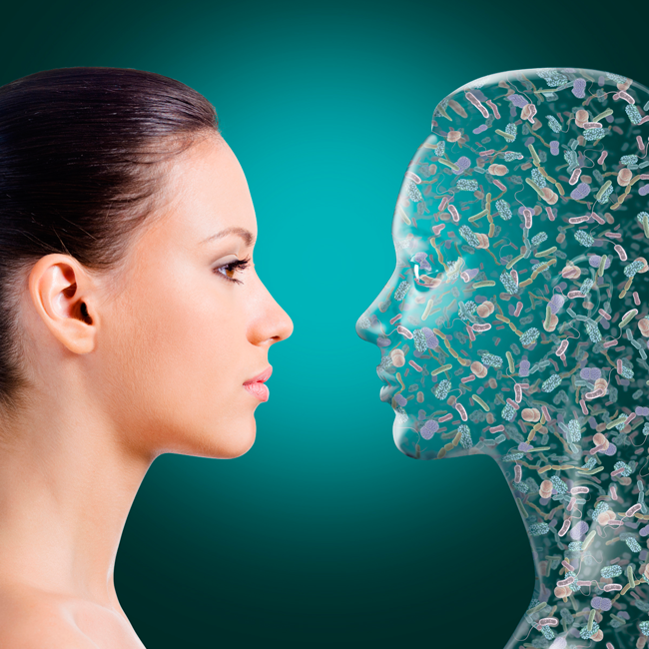
(Nature, 2008)

Slide 6
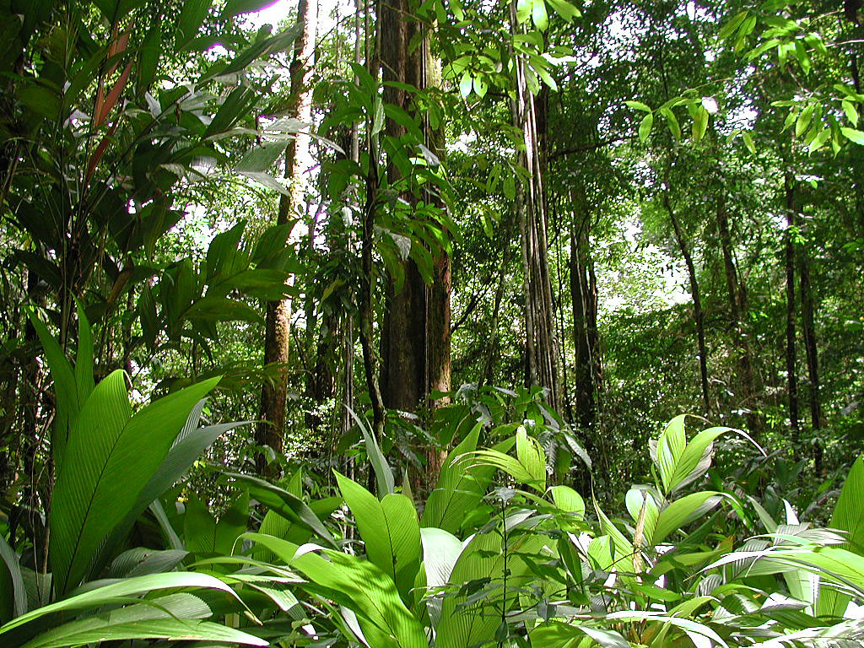
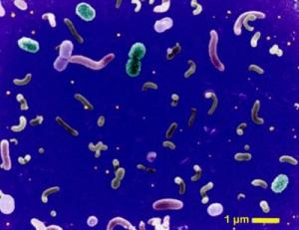
Challenge: Microbial Communities are very diverse
≈
Species:
Spatial
Scale:
1 hectare plot of Amazonian Rainforest:
41-79 tree species (>10 cm d)
1 hectare:
~ 50,000 x
the size of a tree
(assuming a 0.2 m² footprint)
Human fecal sample:
~1000 bacterial species
0.5 g fecal (sub)sample:
~ 1,000,000,000,000 x
a bacterium
(assuming a size of 1 μM³)
(Fierer and Lennon, Am Jour Bot, 2011; Black, Dobzhansky and C. Pavan Bot. Jour 1950)

Slide 7

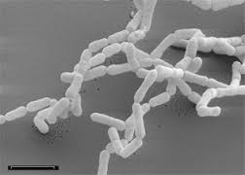
Digoxin
(Cardiac
Glycoside)
Dihydrodigoxin
Eggtherella lenta
(Haiser et al., Science, 2013)

Slide 8
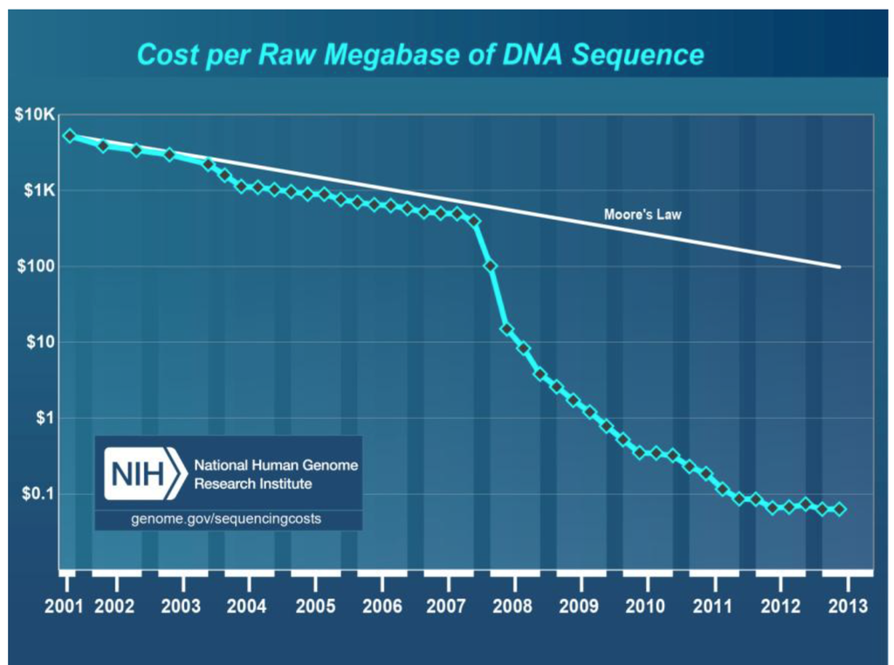
Image:http://www.mdpi.com/viruses/viruses-06-00106/
article_deploy/html/images/viruses-06-00106-g001-1024.png

Slide 9
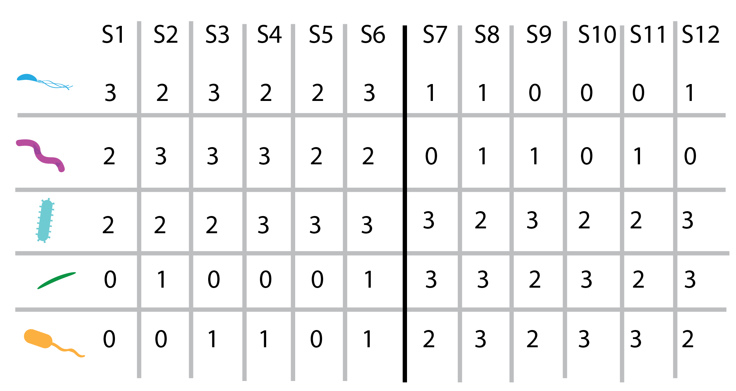

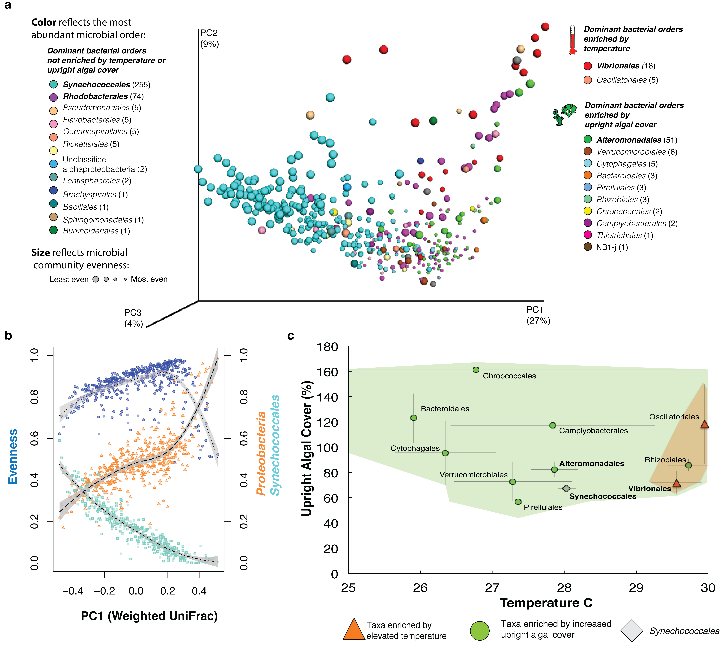

Slide 10
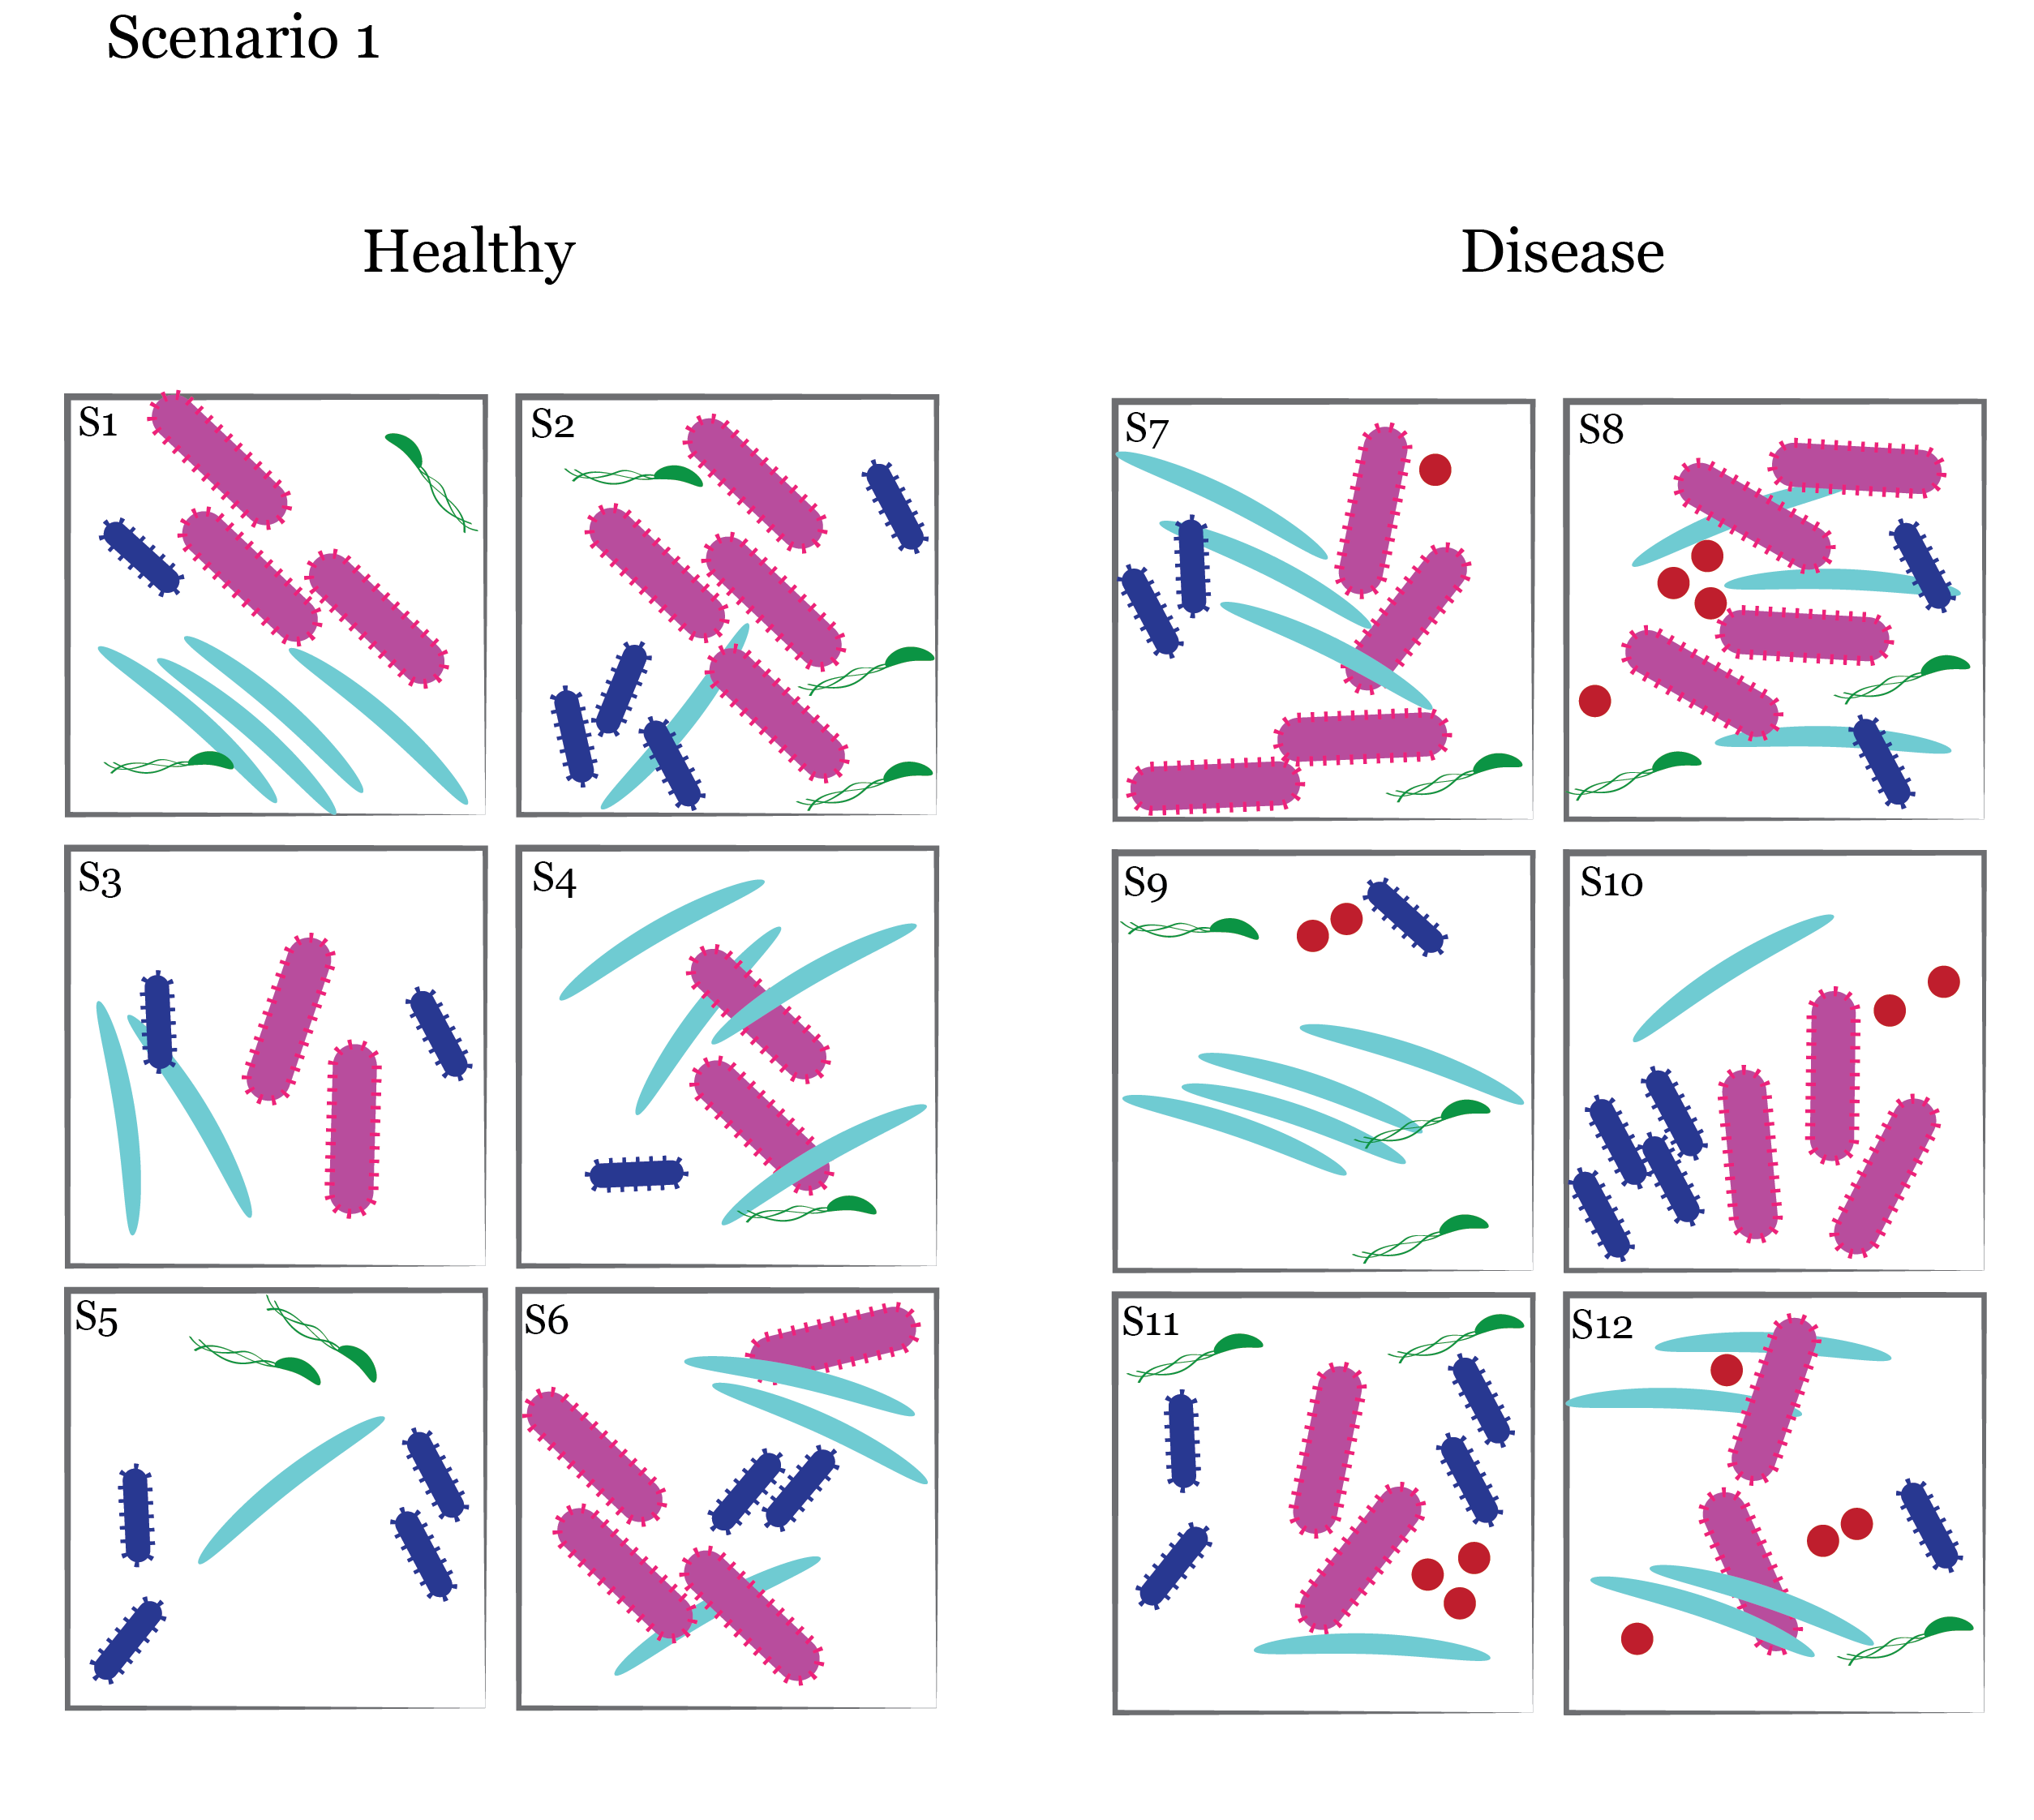
Grab a scenario and find a group- there are enough for 5 groups.
The boxes represent microbial communities from 6 healthy patients and 6 other patients with a disease. Assume the different colors / shapes are different
bacterial types.
Consider what kind of microbial
community change might be causing disease (e.g. propose a hypothesis).
Counting or making a table can help- but for now don’t worry about trying to
run stats.
If you’ve got a strong idea about disease,
try seeing if you notice any relationships
between the microbial types.

Slide 12
Specific Pathogen

Slide 13
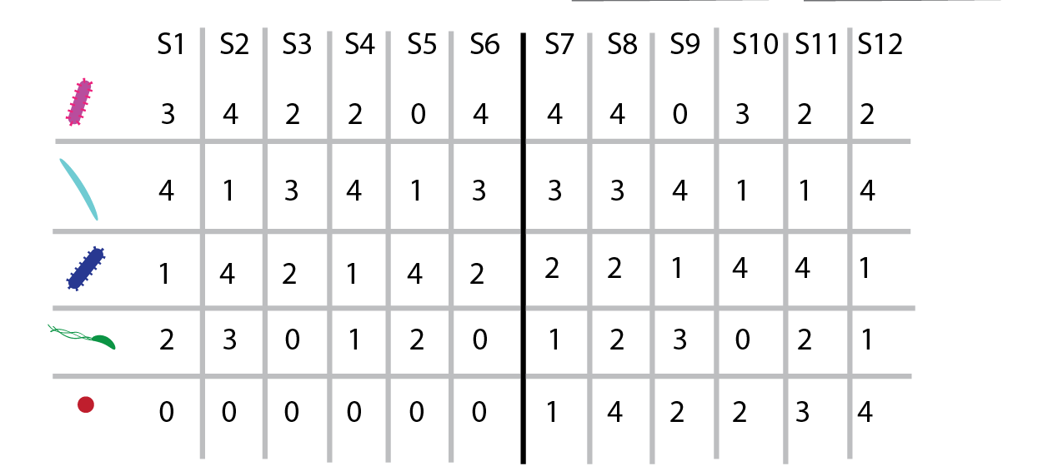
Specific Pathogen
Healthy
Diseased

Slide 14
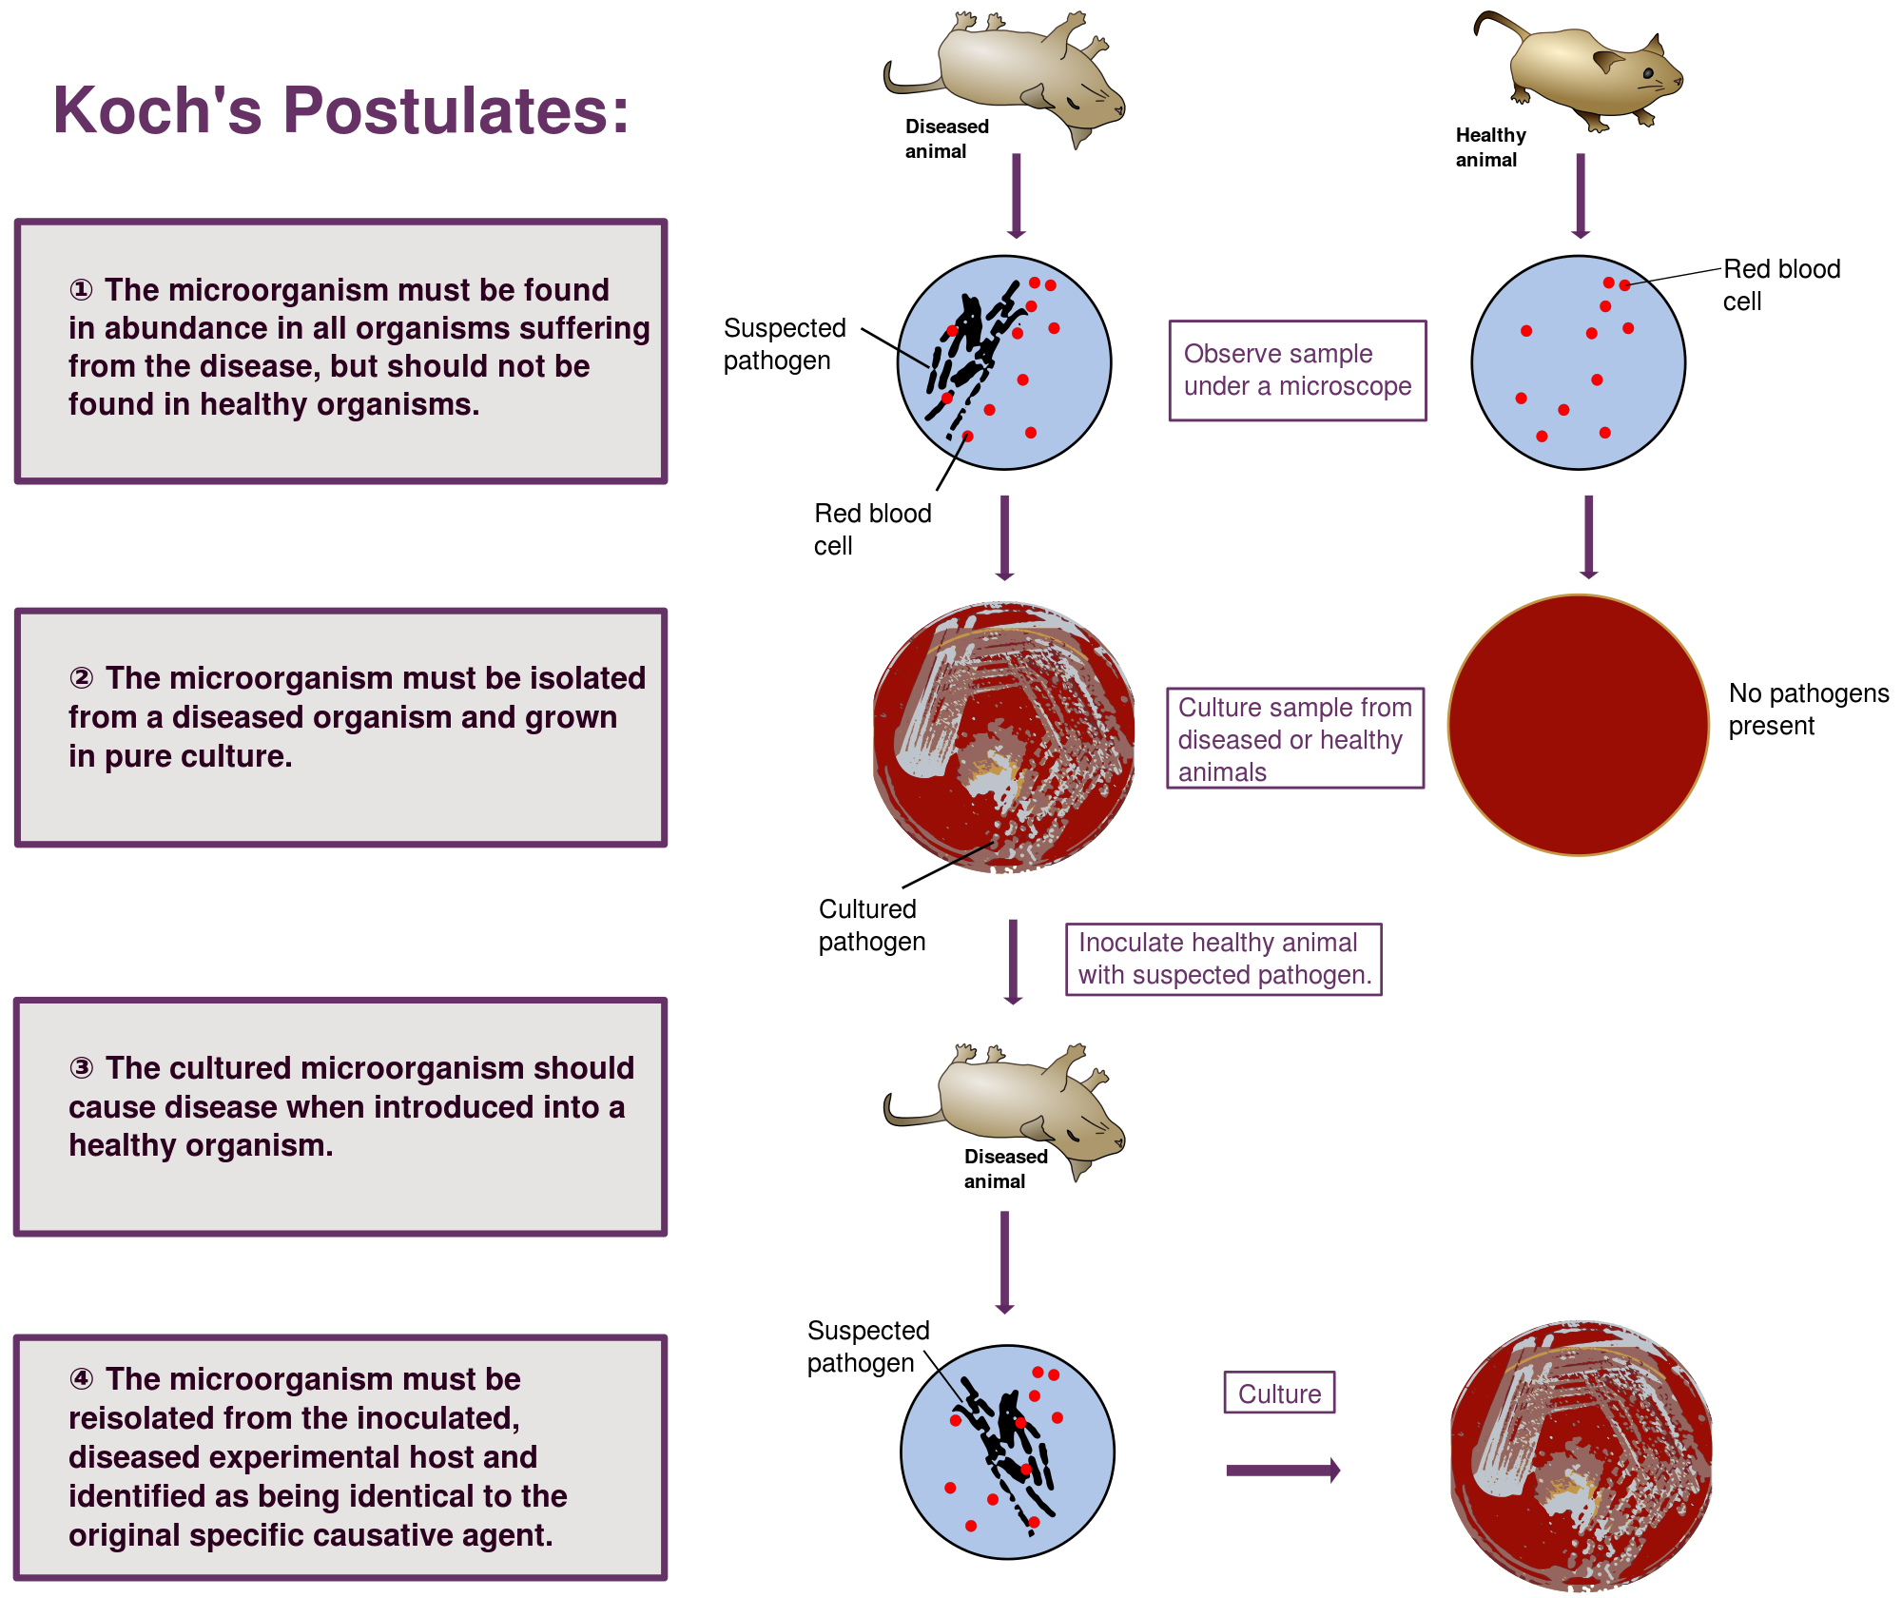
Source: Mike Jones (CC Share-alike 3.0)
Notes:
Details on the image:
This is a Creative Commons image from Mike Jones.
Image URL: https://commons.wikimedia.org/wiki/File:Koch%27s_Postulates.svg

Slide 15
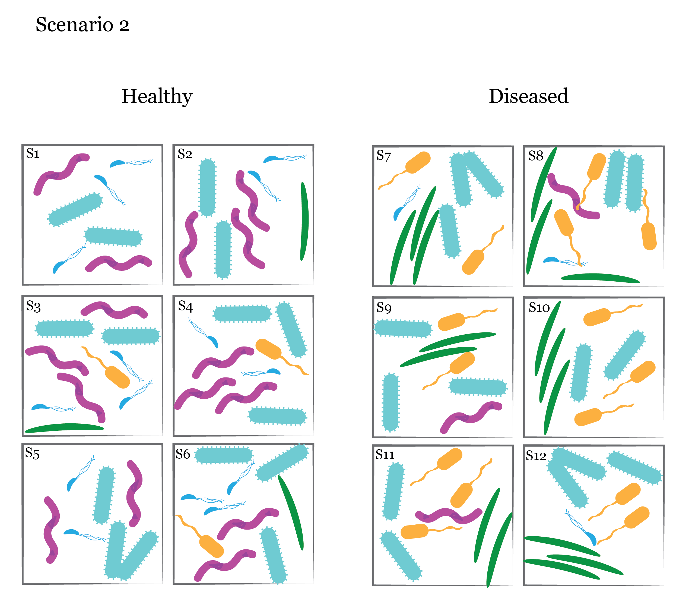

Slide 16
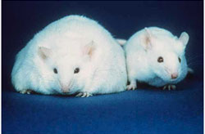
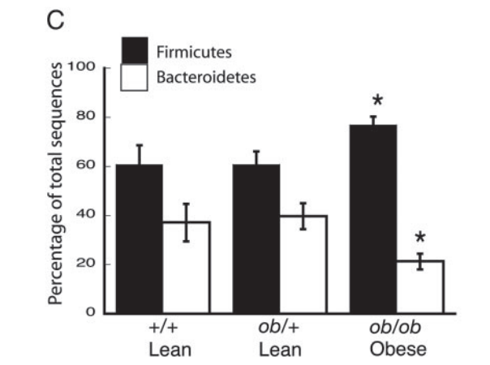
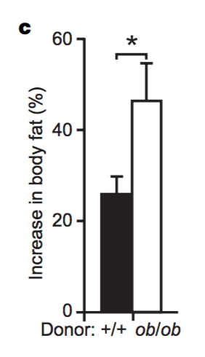
Ley, R. E. et al. “Obesity alters gut microbia
ecology”. PNAS 2005
,
Turnbaugh et al, “An obesity-associated gut microbiome with increased capacity for energy harvest”, Nature 2006

Slide 17
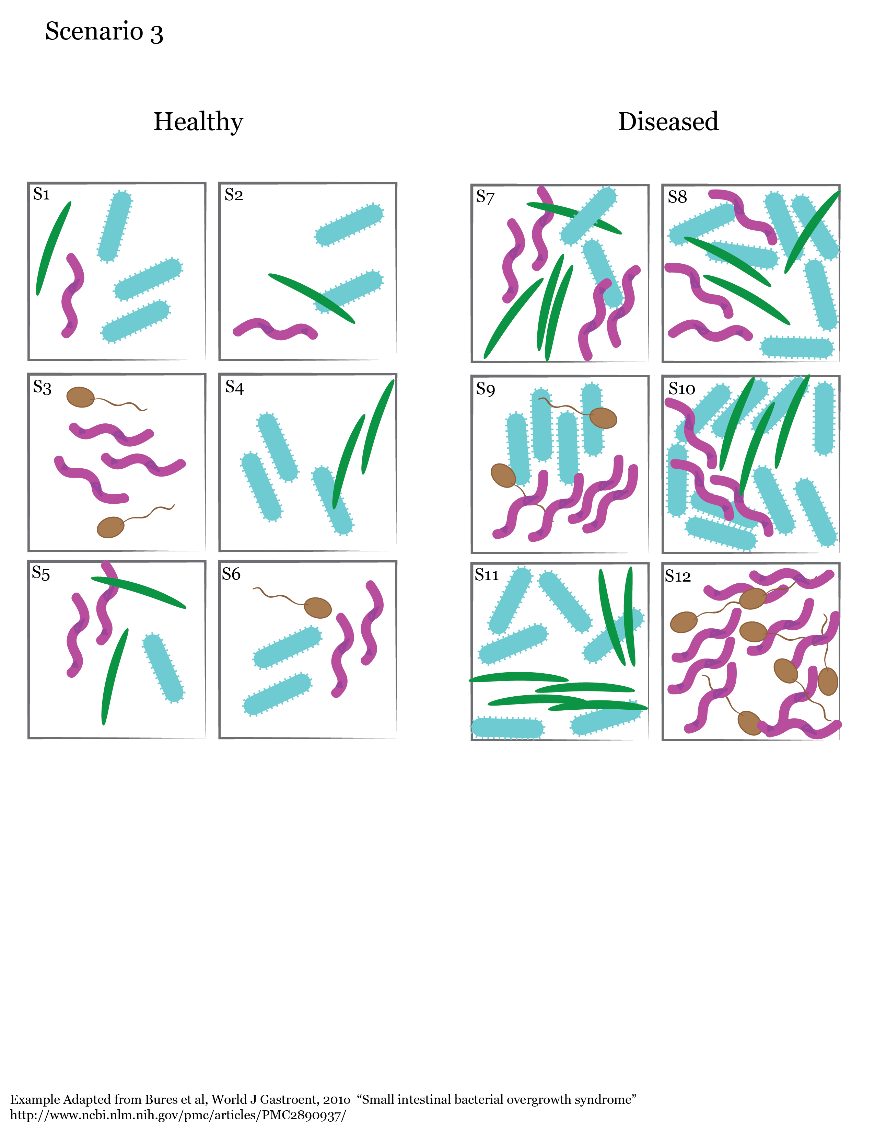
Scenario 3

Slide 18
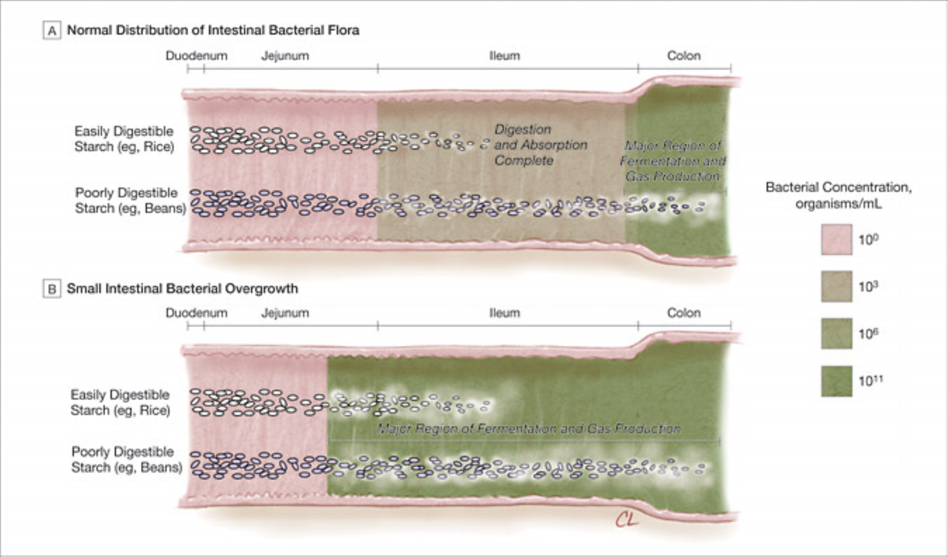
From: Small Intestinal Bacterial Overgrowth: A Framework for Understanding Irritable Bowel Syndrome
JAMA. 2004;292(7):852-858. doi:10.1001/jama.292.7.852
Date of download: 2/5/2016
Copyright © 2016 American Medical Association. All rights reserved.
Notes:
A, In the normal gut, easily digestible starch undergoes complete digestion and absorption within the proximal small intestine and is not available for fermentation in the distal ileum and colon where bacterial colonization is the greatest. In contrast, gas production results from bacterial fermentation of poorly digestible starch that is not assimilated by the proximal gut. B, In small intestinal bacterial overgrowth, the concentration of bacterial flora increases proximally allowing fermentation of both easily digestible and poorly digestible starches.

Slide 19
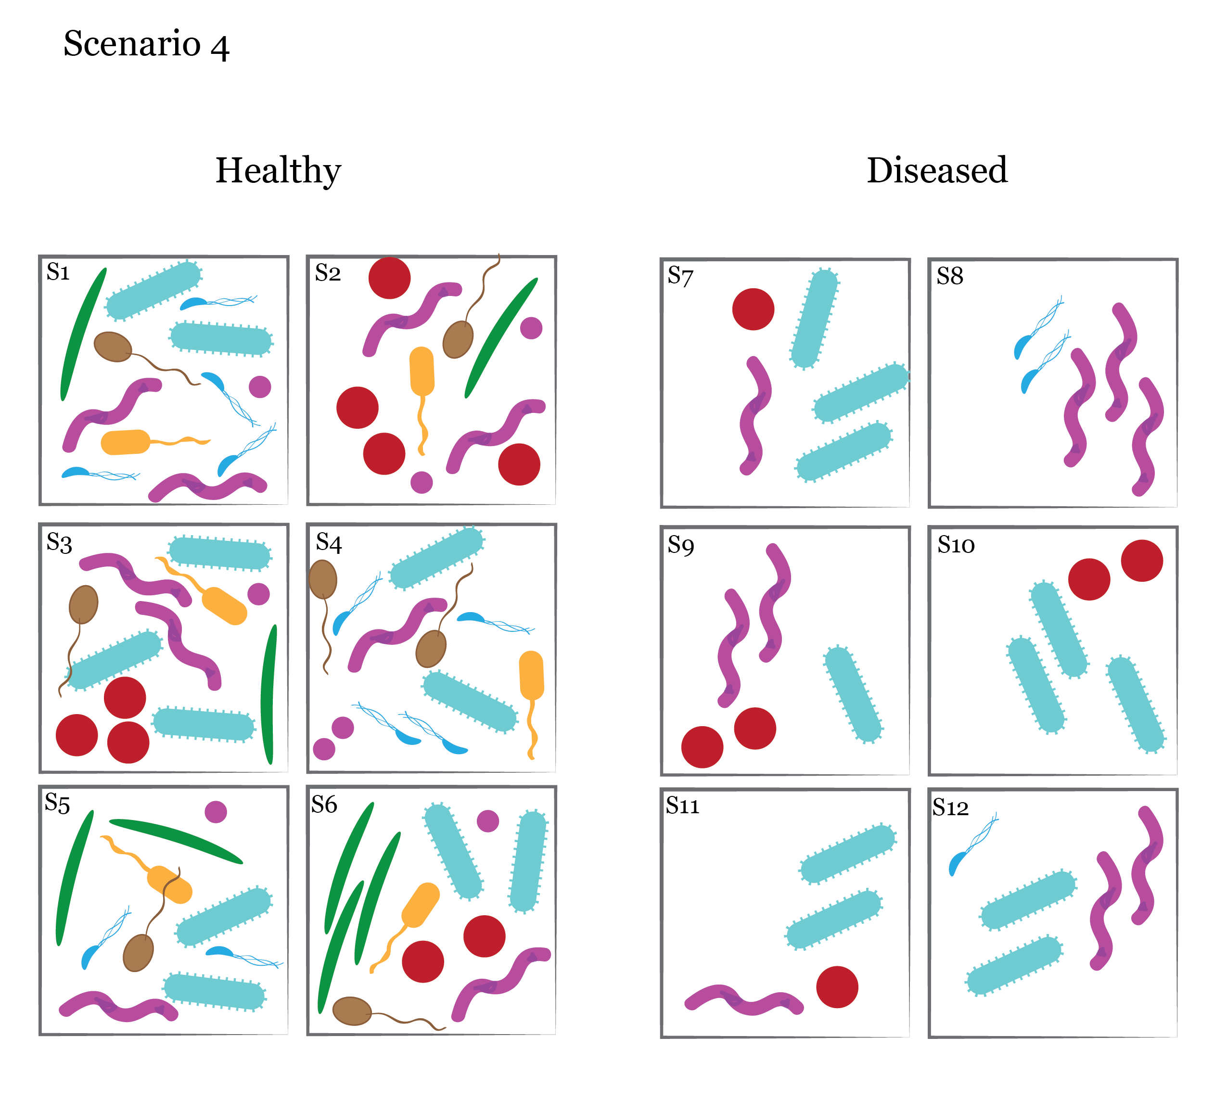

Slide 20
6-7 species
2-3 Species

Slide 21
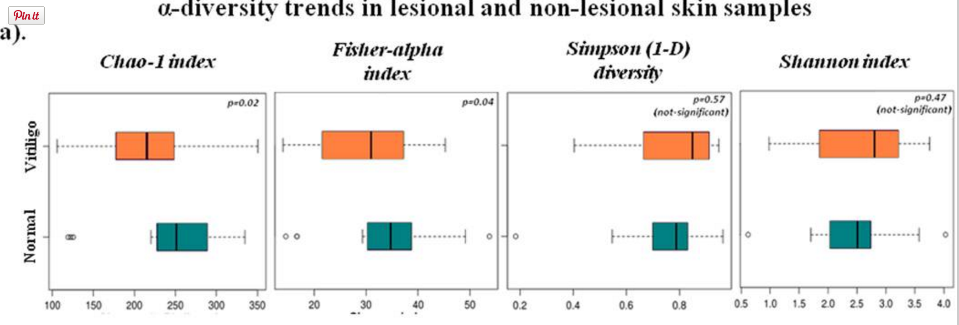
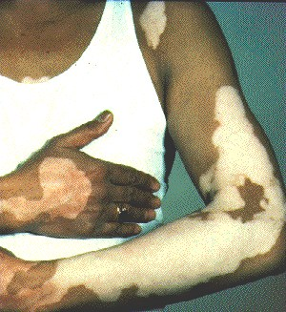
Many examples: Low-grade inflammatory response and obesity (gut microbiome); Vitiligo lesions;
Skin/Vitligo Example: Ganju et al, Scientific Reports 2016, “Microbial community profiling shows dysbiosis in the lesional skin of Vitiligo subjects
Gut/Obesity Example: Le Chatelier et al., Nature 2015,
“Richness of Human Microbiome correlates with metabolic markers”
Image: http://m.patient.media/images/dis127.jpg

Slide 22
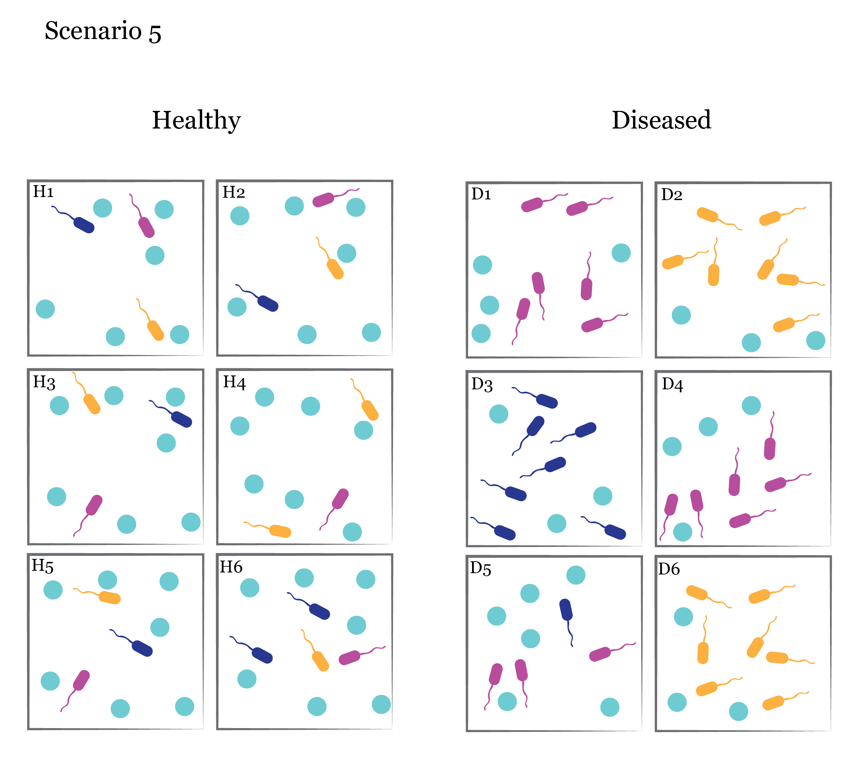

Slide 23
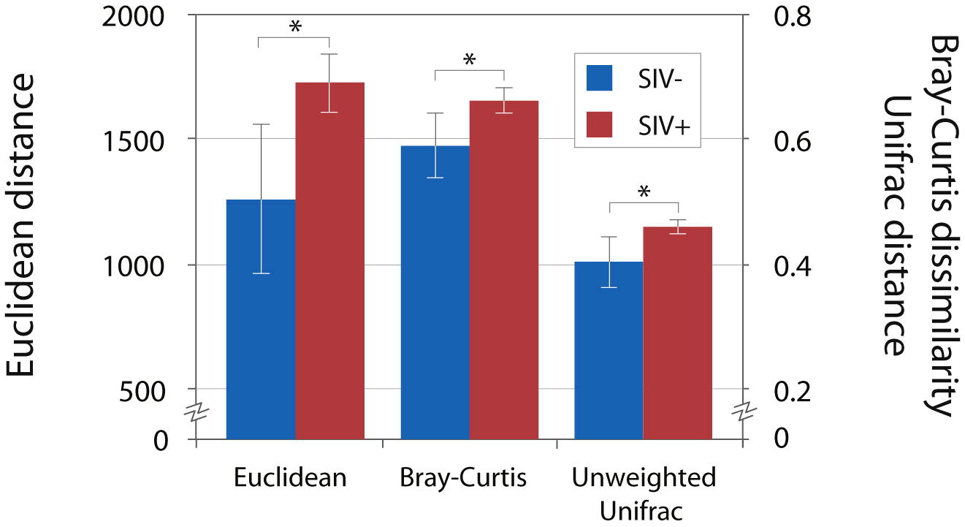
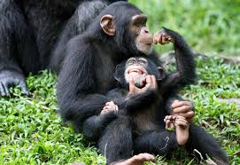
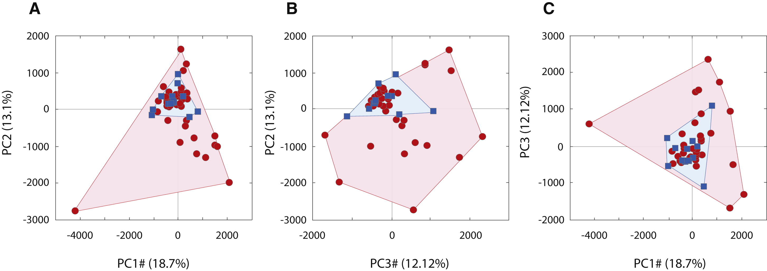
Microbial instability is largely unrecognized, but occurs in multiple systems where animal hosts lose control: untreated AIDs, feline FIV, smokers’ lungs, and SIV+ wild chimpanzees
(Moeller et al. Cell Host & Microbe 2013)

Slide 24



The Take Home
We can think about differences in microbial communities from several
perspectives, including specific pathogens, overall community composition,
cell counts, richness (α-diversity), and variability between sites or samples
(β-diversity)
At the same time, we can look at things from the point of view of microbes,
and check for signs of competition, cooperation, co-occurrence or mutual
exclusion.
Together these perspectives covers the core hypotheses of most
microbial ecology studies in medical and environmental applications
Source:
http://thechinabowl.com/wp-content/uploads/2015/04/Chinese_Fold-Pak_000.jpg
http://www.dezignwithaz.com/images/chinese-takeout-decal.png
http://www.trendus.com/images/hesaplamalar/fortunecookie_close.gif

Slide 25
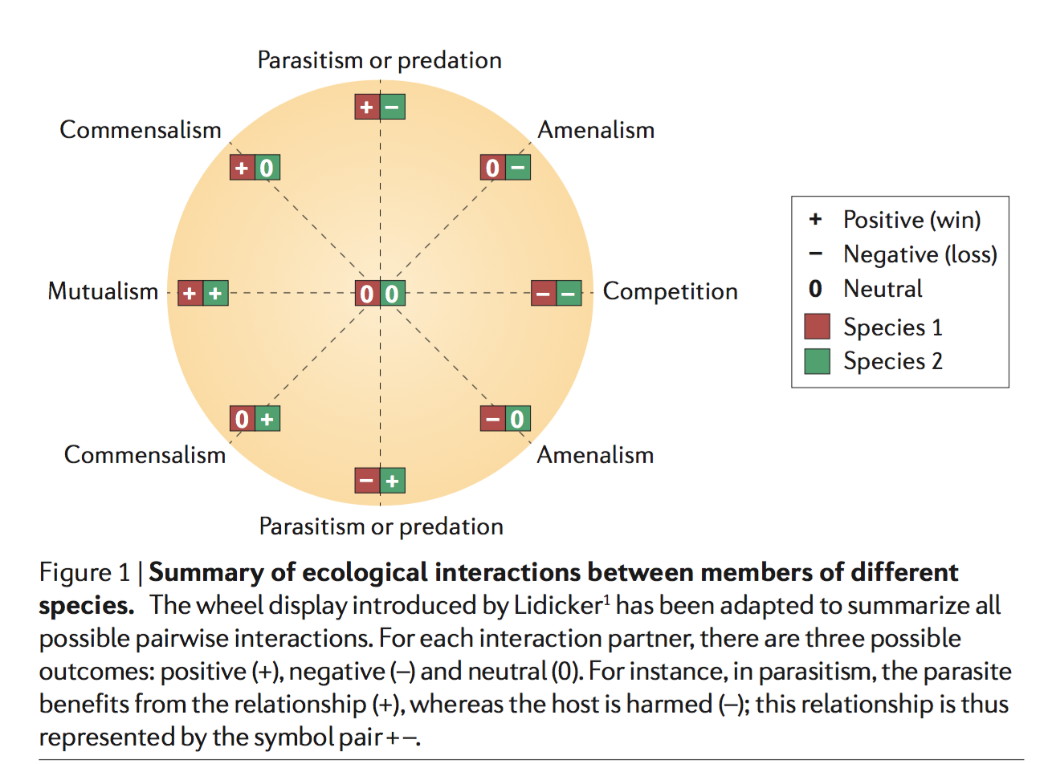
Microbe-microbe interactions
Source:
Faust and Raes, Nat. Reviews Micro, 2012

Slide 27
Competitive exclusion?

Slide 29
Specific Pathogen
Healthy
Diseased

Slide 30
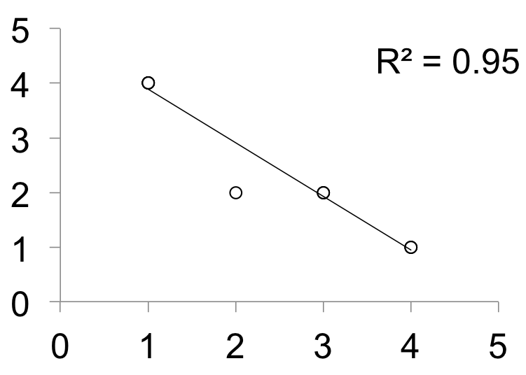
Source: Mike Jones (CC Share-alike 3.0)
Notes:
Details on the image:
This is a Creative Commons image from Mike Jones.
Image URL: https://commons.wikimedia.org/wiki/File:Koch%27s_Postulates.svg

Slide 31
Measuring microbiomes:
β Diversity

Slide 32
Measuring microbiomes:
β Diversity
Quantiative vs. Qualitative Beta-diversity measures:
Qualitative measures count presence/absence of species
Quantitative measures account for abundance
Phylogenetic measure vs. non-Phylogenetic measures:
non-Phylogenetic measures treat all species/OTUs equally
Phylogenetic measures weight species by their evolutionary relationships

Slide 33
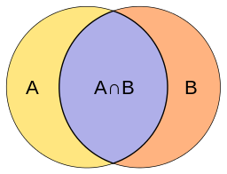
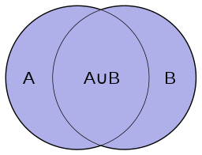
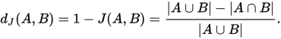
Measuring microbiomes:
β Diversity
How should we measure differences between our communities?
Count how many types are shared vs. unique?

Slide 34
Healthy
Diseased

Slide 35
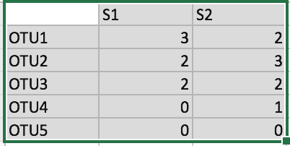
Measuring microbiomes:
β Diversity
Jaccard distance(s1,s2): compares shared vs. unique
OTUs.
S1 and S2 share 3 of 4 OTUs, so they differ
in only 1 of 4 OTUs, or 0.25
Inter-
section
Union

Slide 36
Measuring microbiomes:
β Diversity
Jaccard distance(s1,s2): compares shared vs. unique
OTUs.
More formally:
The intersection of S1 and S2 has
3 OTUs (OTU1,OTU2,OTU3)
The union of S1 and S2 has 4 OTUs (OTU1,OTU2,
OTU3,OTU4)
So we have a Jaccard distance of (4-3)/4 =
¼ = 0.25
Inter-
section
Union

Slide 37
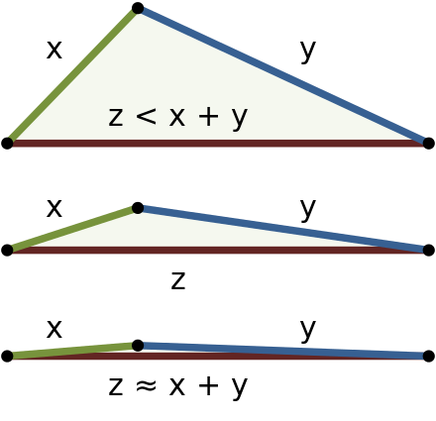
Measuring microbiomes:
Triangle inequality
For a measure of community dissimilarity
to be a distance, it must fulfill the
triangle inequality:
Phrased in terms of some proposed
distance d:

Slide 38
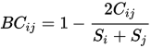
Measuring microbiomes: β Diversity
Bray-Curtis Dissimilarity
Bray-Curtis dissimilarity (s1,s2):
Sum of lesser
value of each
pair of species
shared between sites
S_{i} = 7
S_{j} = 8
Total OTUs
Counted at site i
Total OTUs
Counted at site j
Let’s call S1 i and S2 j
C_{ij} = min(3,2) + min(2,3) + min(2,2) = 2 + 2 + 2 = 6
So 2C_{ij} = 12
and the Bray-Curtis divergence Bc_{ij} = 12/15 = 4/5 = 0.80

Slide 39
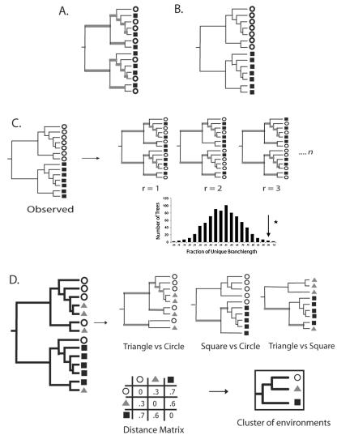
Unweighted UniFrac (Qualitative, Phylogenetic)
Source: Lozupone and Knight,AEM, 2005

Slide 40
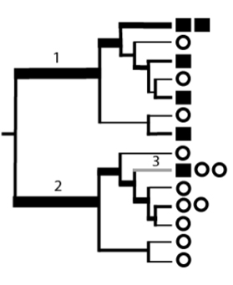
Weighted UniFrac (Quantitative, Phylogenetic)
Bacteria in this group are
mostly represented in the
square environment
Bacteria in this group are
mostly represented in the
circle environment
Source: Lozupone and Knight,AEM, 2005

Slide 41
Source: Pollock et al., Submitted, 2017

